Slide 1
VIDEO GAME SALES DATASET
Description:
The growth of Videogames are increasing among all age people. The dataset is one of the historical sales of Videogames which has recorded in different genre, publisher and years. Predictive data analytics methods are easy to apply with this dataset.
Rank (Unique and Independent)
Name (Category data-Nominal)
Platform (Category data-Nominal)
Year (Qualitative ordinal)
Genre (Category data-Nominal)
Publisher (Category data-Nominal)
NA Sales (Continuous data-Decimal)
EU Sales (Continuous data-Decimal)
JP Sales (Continuous data-Decimal)
Other Sales (Continuous data-Decimal)
Global Sales (Continuous data-Decimal)

Slide 2
Question :
1.Which Video Game Genre has top 10 Total Sales (before and after the year 2000) ?
2.Which Gaming platform is mostly used (before and after the year 2000) ?
3.Which Game publisher earns most profit ?
Reference:
KAGGLE( https://www.kaggle.com/gregorut/videogamesales )
by Gregory Smith
Data Engineer at Petzl America
West Point, Utah, United States.
How much Data:
Total no of rows/records/observation : 16599
Total no of columns/features/variable : 11

Slide 3
Category:
1.Year Type:
Year Type is calculated by the Year and it have three categories, namely, Before 2000 and After 2000.
2.Sales Type:
Sales Type is calculate by the Global Sales and it have three categories, namely, Hit, Average and Flop.
Aggregates:
1.Global Sales:
It is derived by adding NA sales, EU sales, JP sales and Other sales.

Slide 4
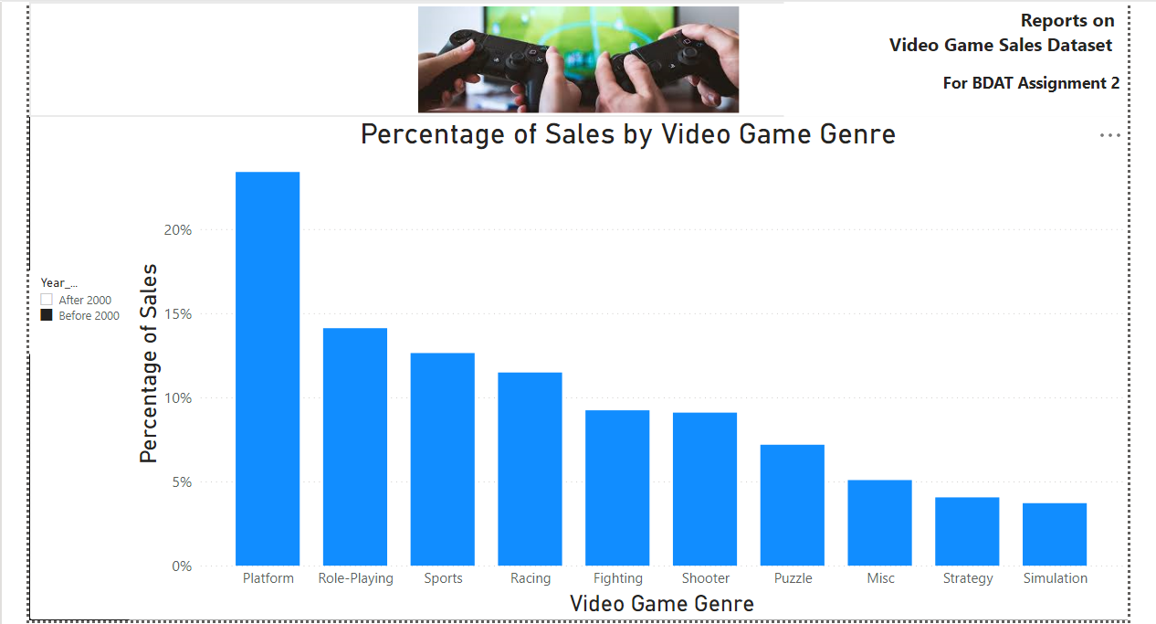
Data Visualization using Power BI

Slide 5
PIZZA RESTAURANT DATASET
Description:
This Dataset have over 3,500 pizzas from multiple restaurants provided by Datafiniti's Business Database. The dataset includes the category, name, address, city, state, menu information, price range, and more for each pizza restaurant. Datafiniti provides instant access to web data. We compile data from thousands of websites to create standardized databases of business, product, and property information.
Question :
1.Find the top 10 costliest Restaurants for Pizza in both US AND UK
2.Find the top 10 cheapest Restaurants for Pizza in both US AND UK
3.What is the median price of a large plain pizza across the U.S.?

Slide 6
Reference:
KAGGLE(https://www.kaggle.com/datafiniti/pizza-restaurants-and-the-pizza-they-sell)
BY
Datafiniti.
How much Data:
Total no of rows/records/observation : 3511
Total no of columns/features/variable : 20

Slide 7
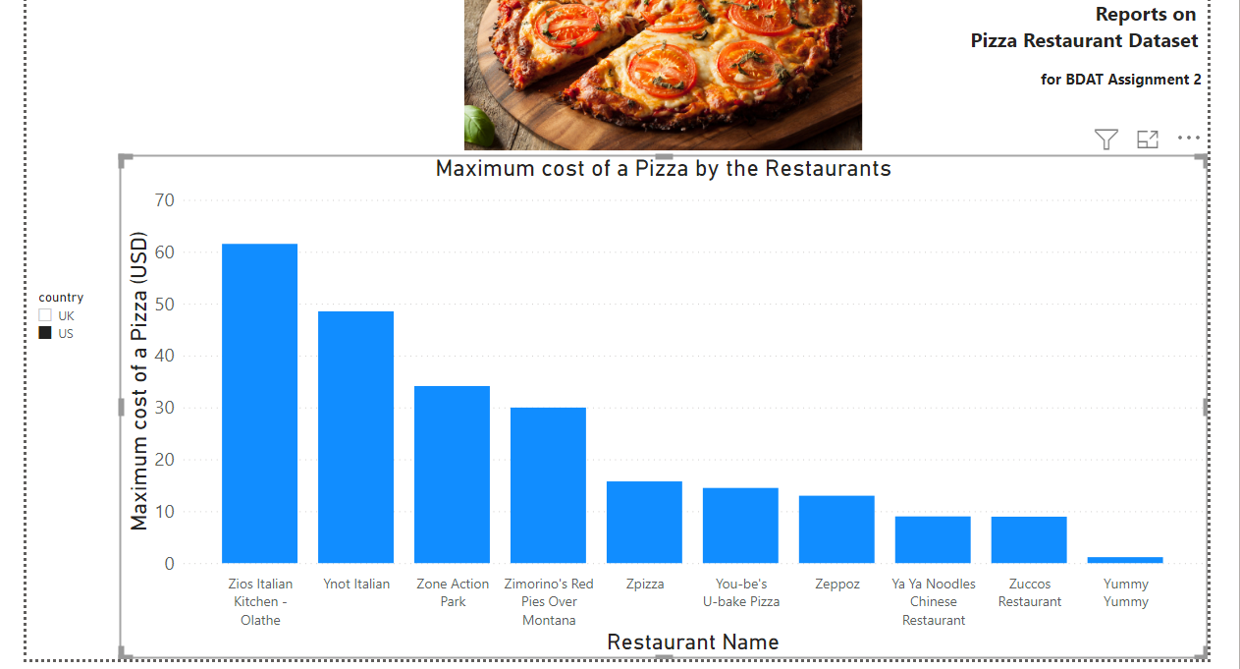
Data Visualization using Power BI

Slide 8
SUPPLY CHAIN MANAGEMENT DATASET
Description:
The growth of Supply Chain Management is increasing. And nowadays, market competitions are also high. This dataset contains data of a Canada's Supply Chain Company, which has recorded in 3 different Shipping Modes for 12 months. Predictive data analytics methods are easy to apply with this dataset.
1. Order id (UNIQUE AND INDEPENDENT)
2. Order Date (DATE FORMAT)
3. Order Priority (CATEGORY DATA – NOMINAL)
4. Order Quantity (DISCRETE DATA)
5. Sales (CONTINIOUS DATA – DECIMAL)
6. Unit Price (CONTINIOUS DATA – DECIMAL)
7. Ship Mode (CATEGORICAL DATA - NOMINAL)
8. Shipping Cost (CONTINUOUS DATA - DECIMAL)

Slide 9
9. Province (CATEGORICAL DATA – NOMINAL)
10. Customer Segment (CATEGORICAL DATA - NOMINAL)
11.Product Category (CATEGORICAL DATA - NOMINAL)
12. Product Sub-Category (CATEGORICAL DATA - NOMINAL)
13.Product Container (CATEGORICAL DATA - NOMINAL)
14.Ship Date (DATE FORMAT)
Question :
1.Which 10 Province has the highest percentage of Order Quantity on different product category ?
2.which is the most bought sub-category product under each product category ?
3.find some solution to reduce the shipping cost.

Slide 10
Reference:
COURSERA( https://www.coursera.org/learn/excel-data-analysis/supplement/Vde5D/store-sales-comma-delimited-txt )
How much Data:
Total no of rows/records/observation : 2003
Total no of columns/features/variable : 14
Category:
1.Quantity Type: Quantity Type is calculated by the Order Quantity and it have six categories, namely XS,S,M,L,XL,XXL.
2.Customer Segment Code: Customer Segment Code is calculate by the Customer Segment and it have four categories, namely 1,2,3,4.
Aggregates:
1.Unit Price – It is derived by Sales/Order Quantity.

Slide 11
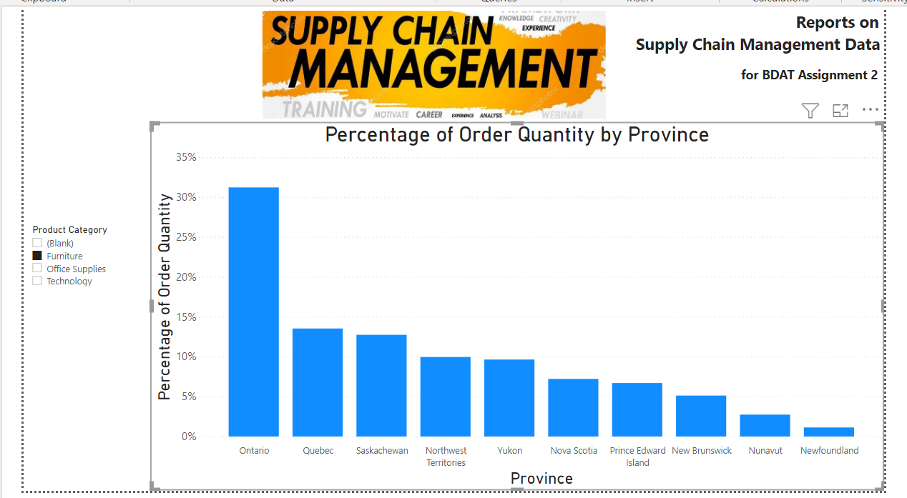
Data Visualization using Power BI

